Slide 1

Chapter 12
Cryptographic
Hash Functions
Copyright © The McGraw-Hill Companies, Inc. Permission required for reproduction or display.
12.<number>

Slide 2
Chapter 12
Objectives
To introduce general ideas behind cryptographic
hash functions
To discuss the Merkle-Damgard scheme as the basis
for iterated hash functions
To distinguish between two categories of hash
functions:
To discuss the structure of SHA-512.
To discuss the structure of Whirlpool.
12.<number>

Slide 3
12-1 INTRODUCTION
A cryptographic hash function takes a message of arbitrary length and creates a message digest of fixed length. The ultimate goal of this chapter is to discuss the details of the two most promising cryptographic hash algorithms⎯ SHA-512 and Whirlpool.
Topics discussed in this section:
12.1.1 Iterated Hash Function
12.1.2 Two Groups of Compression Functions
12.<number>

Slide 4
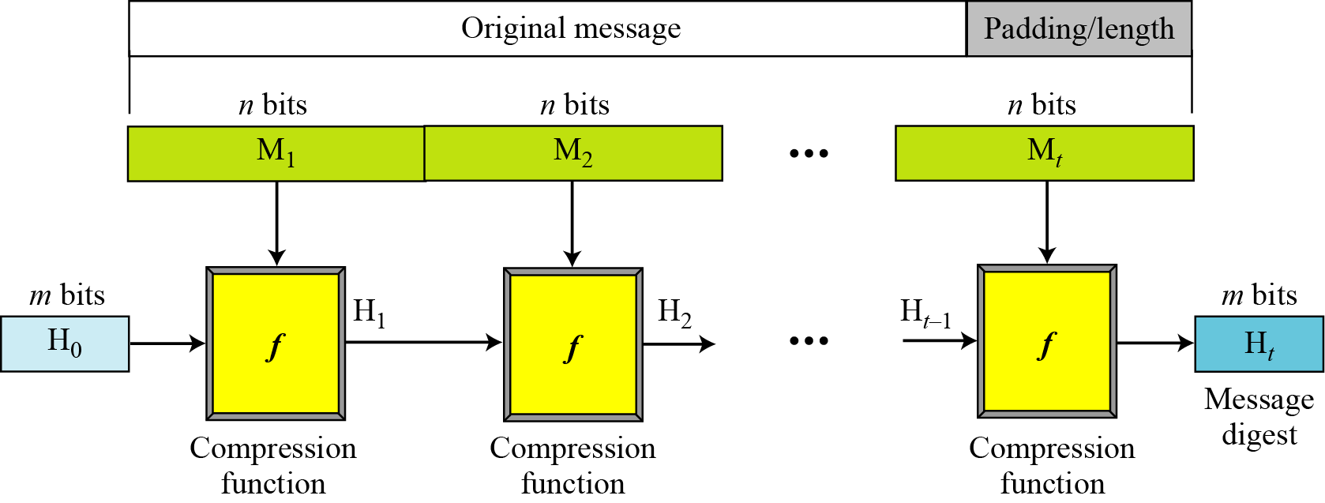
12.1.1 Iterated Hash Function
Merkle-Damgard Scheme
Figure 12.1 Merkle-Damgard scheme
12.<number>

Slide 5
12.1.2 Two Groups of Compression Functions
1. The compression function is made from scratch.
Message Digest (MD)
2. A symmetric-key block cipher serves as a compression function.
Whirlpool
12.<number>

Slide 6
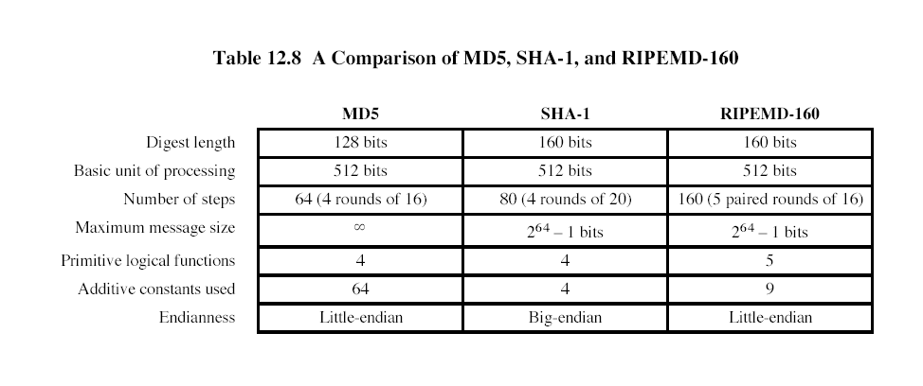

Slide 7
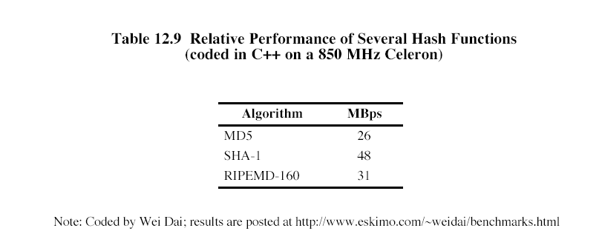

Slide 8
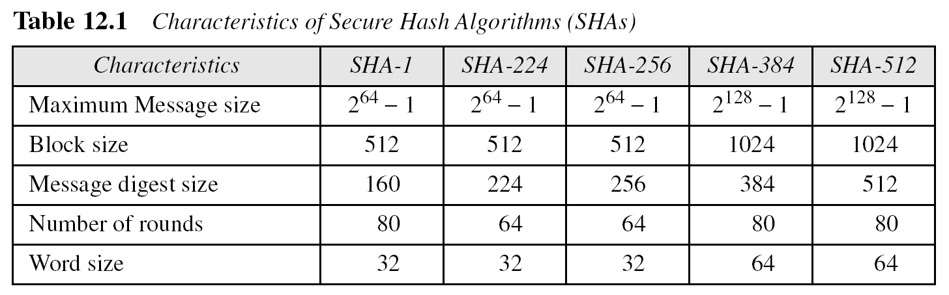
12.1.2 Continued
12.<number>

Slide 9
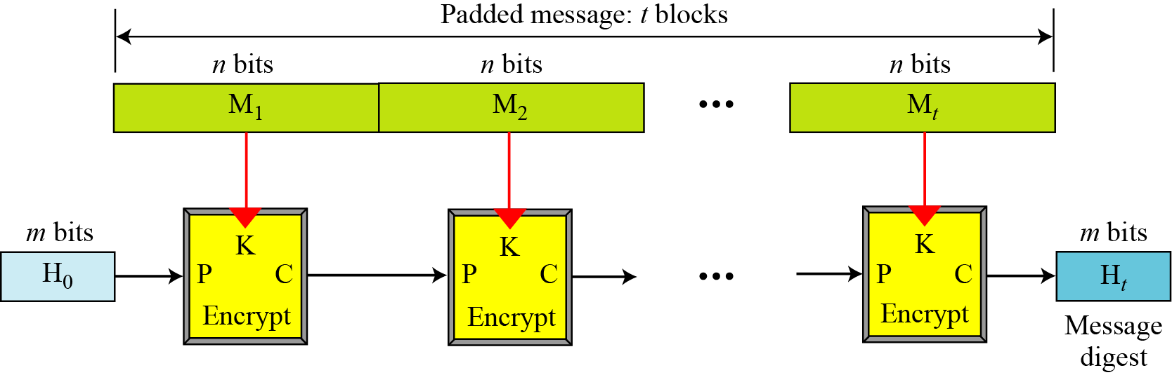
12.1.2 Continued
Rabin Scheme
Figure 12.2 Rabin scheme
12.<number>

Slide 10
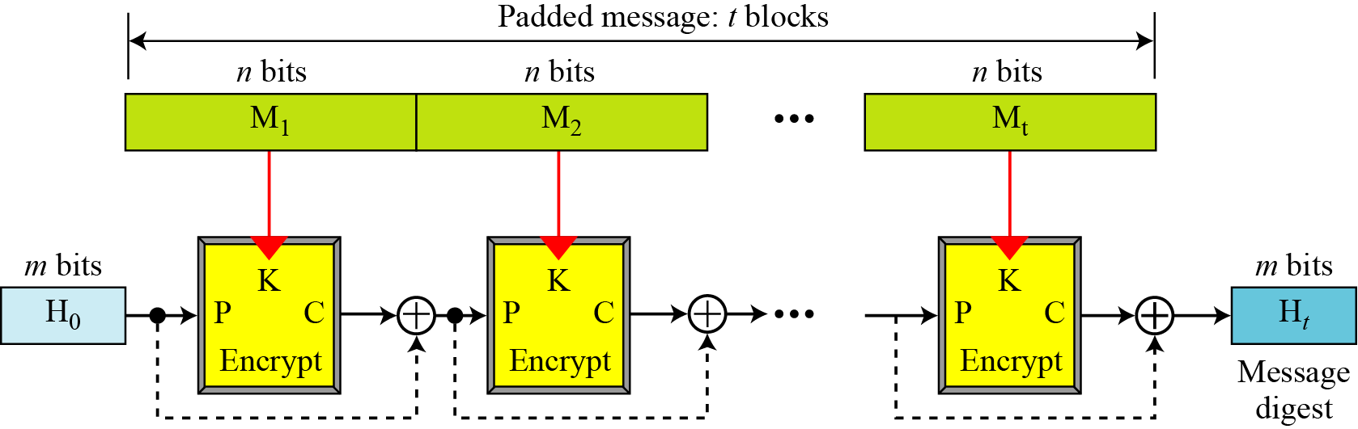
12.1.2 Continued
Davies-Meyer Scheme
Figure 12.3 Davies-Meyer scheme
12.<number>

Slide 11
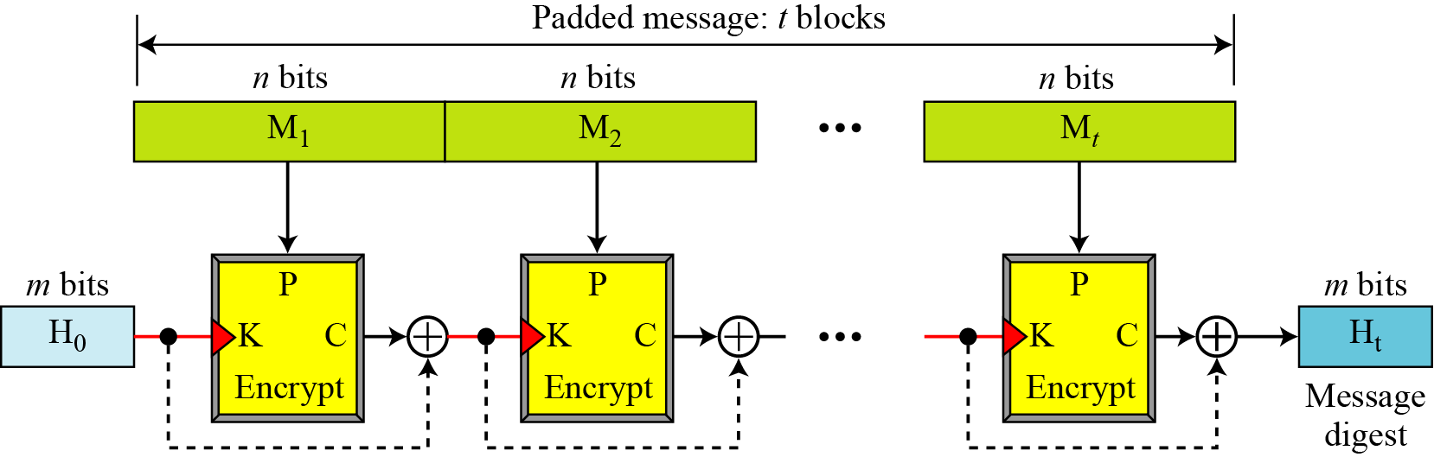
12.1.2 Continued
Matyas-Meyer-Oseas Scheme
Figure 12.4 Matyas-Meyer-Oseas scheme
12.<number>

Slide 12
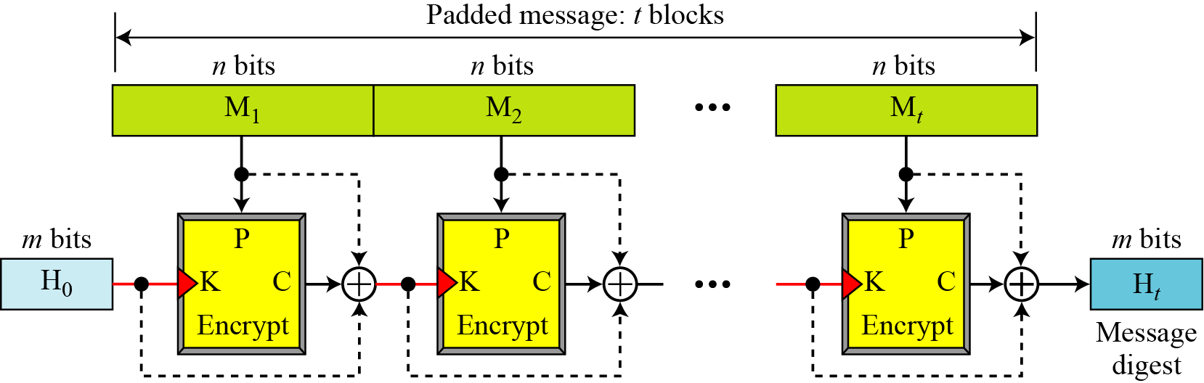
12.1.2 Continued
Miyaguchi-Preneel Scheme
Figure 12.5 Miyaguchi-Preneel scheme
12.<number>

Slide 13
12-2 SHA-512
SHA-512 is the version of SHA with a 512-bit message digest. This version, like the others in the SHA family of algorithms, is based on the Merkle-Damgard scheme.
Topics discussed in this section:
12.2.1 Introduction
12.2.2 Compression Function
12.2.3 Analysis
12.<number>

Slide 14
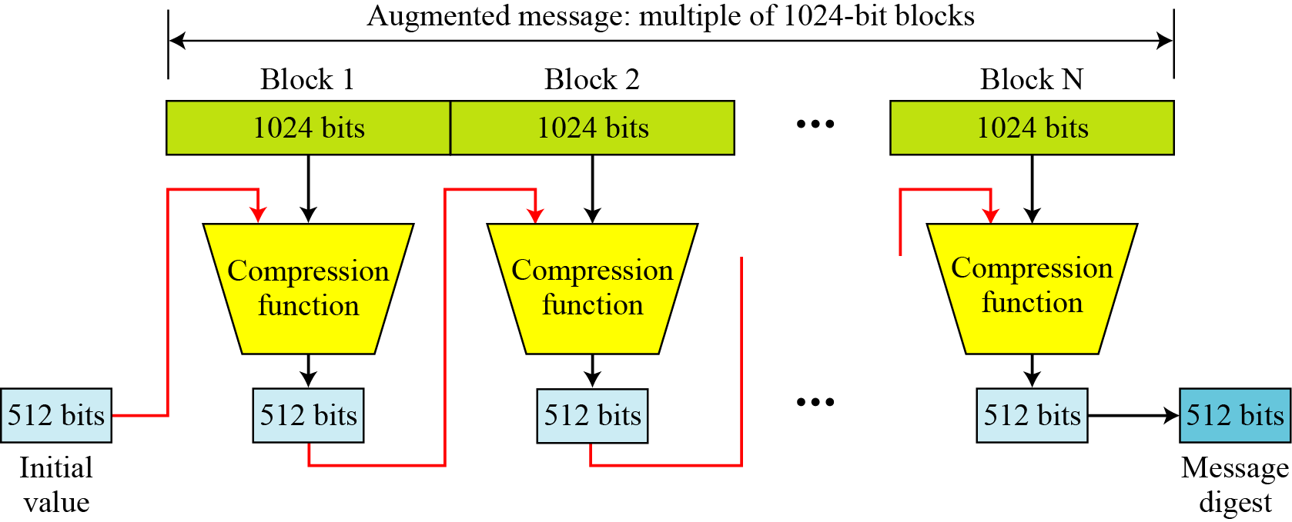
12.2.1 Introduction
Figure 12.6 Message digest creation SHA-512
12.<number>

Slide 15

12.2.1 Continued
Message Preparation
SHA-512 insists that the length of the original message be less than 2¹²⁸ bits.
Note
SHA-512 creates a 512-bit message digest out of a message less than 2¹²⁸.
12.<number>

Slide 16
12.2.1 Continued
Example 12.1
This example shows that the message length limitation of SHA-512 is not a serious problem. Suppose we need to send a message that is 2¹²⁸ bits in length. How long does it take for a communications network with a data rate of 2⁶⁴ bits per second to send this message?
Solution
A communications network that can send 2⁶⁴ bits per second is not yet available. Even if it were, it would take many years to send this message. This tells us that we do not need to worry about the SHA-512 message length restriction.
12.<number>

Slide 17
12.2.1 Continued
Example 12.2
This example also concerns the message length in SHA-512. How many pages are occupied by a message of 2¹²⁸ bits?
Solution
Suppose that a character is 32, or 2⁶, bits. Each page is less than 2048, or approximately 2¹², characters. So 2¹²⁸ bits need at least 2¹²⁸ / 2¹⁸, or 2¹¹⁰, pages. This again shows that we need not worry about the message length restriction.
12.<number>

Slide 18
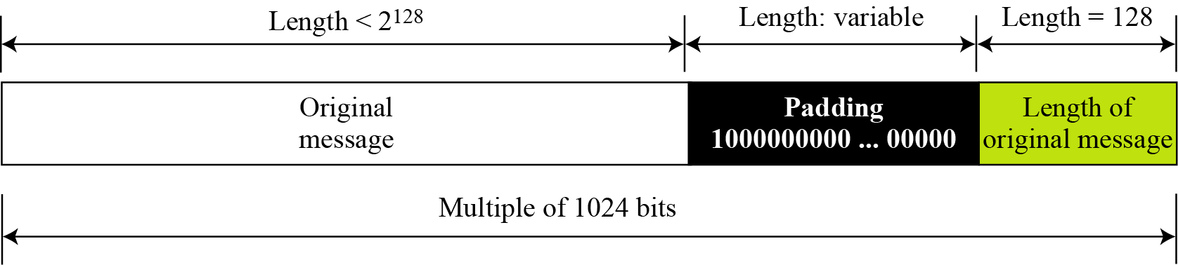
12.2.1 Continued
Figure 12.7 Padding and length field in SHA-512
12.<number>

Slide 19
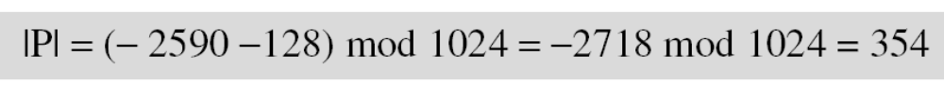
12.2.1 Continued
Example 12.3
What is the number of padding bits if the length of the original message is 2590 bits?
Solution
We can calculate the number of padding bits as follows:
The padding consists of one 1 followed by 353 0’s.
12.<number>

Slide 20
12.2.1 Continued
Example 12.4
Do we need padding if the length of the original message is already a multiple of 1024 bits?
Solution
Yes we do, because we need to add the length field. So padding is needed to make the new block a multiple of 1024 bits.
12.<number>

Slide 21
12.2.1 Continued
Example 12.5
What is the minimum and maximum number of padding bits that can be added to a message?
Solution
The minimum length of padding is 0 and it happens when
(−M − 128) mod 1024 is 0. This means that |M| = −128 mod 1024 = 896 mod 1024 bits. In other words, the last block in the original message is 896 bits. We add a 128-bit length field to make the block complete.
12.<number>

Slide 22
12.2.1 Continued
Example 12.5
Continued
The maximum length of padding is 1023 and it happens when (−|M| −128) = 1023 mod 1024. This means that the length of the original message is |M| = (−128 −1023) mod 1024 or the length is |M| = 897 mod 1024. In this case, we cannot just add the length field because the length of the last block exceeds one bit more than 1024. So we need to add 897 bits to complete this block and create a second block of 896 bits. Now the length can be added to make this block complete.
12.<number>

Slide 23
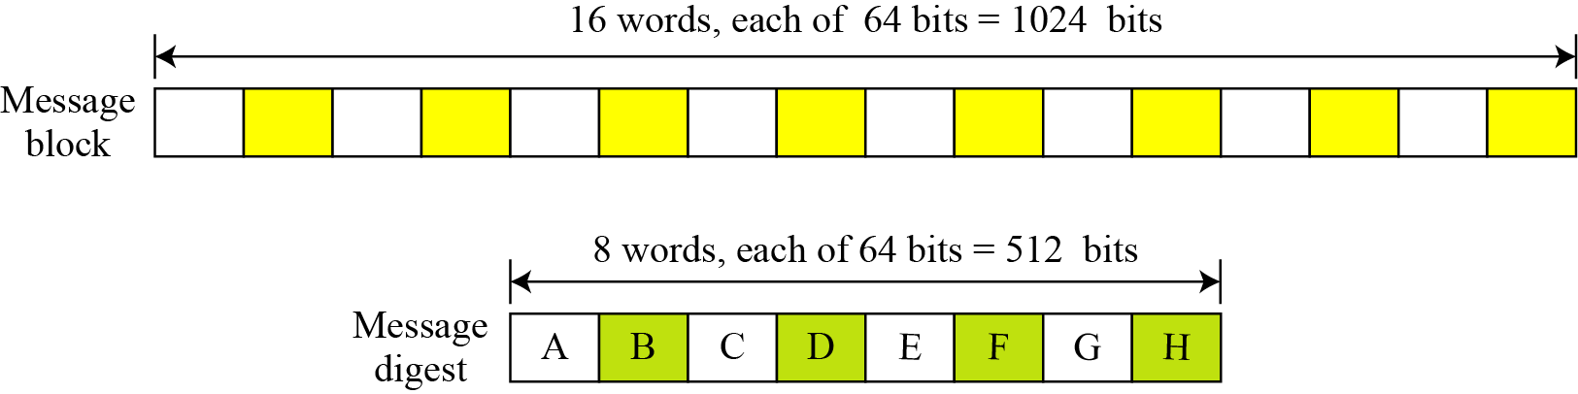
12.2.1 Continued
Words
Figure 12.8 A message block and the digest as words
12.<number>

Slide 24
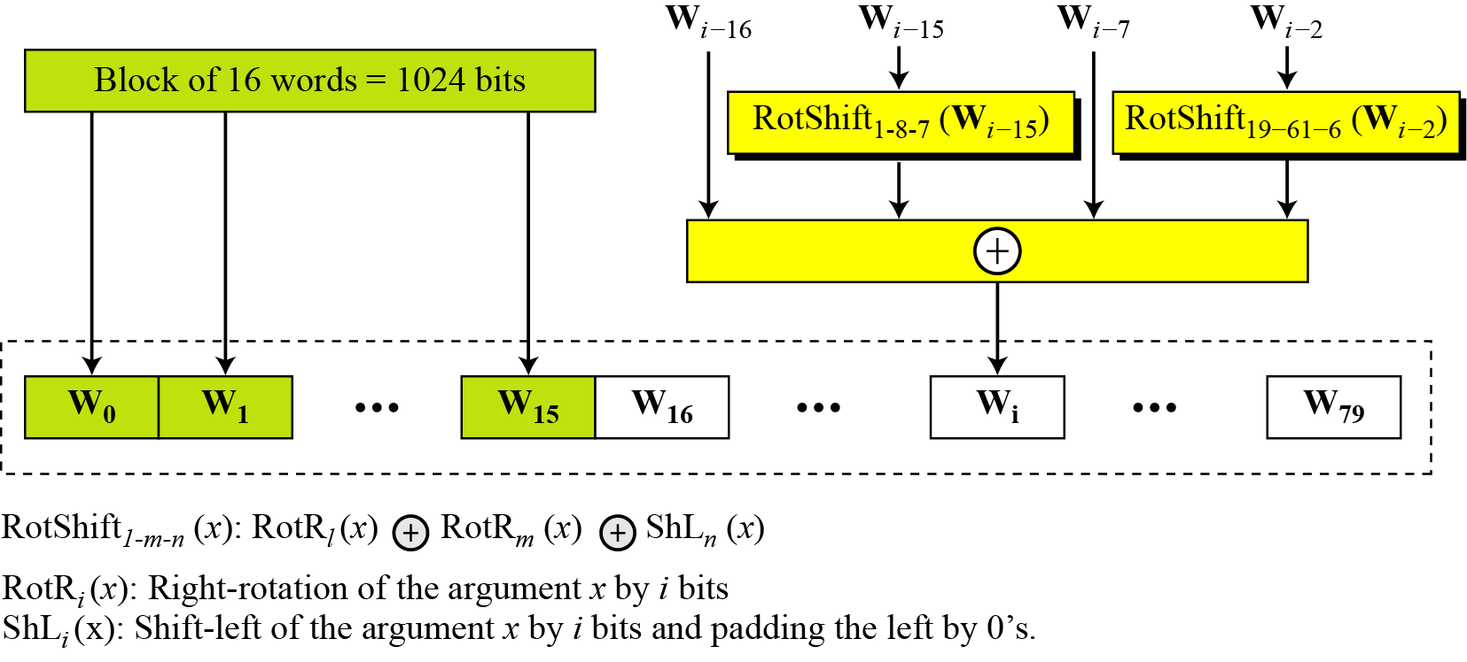
12.2.1 Continued
Word Expansion
Figure 12.9 Word expansion in SHA-512
12.<number>

Slide 25
12.2.1 Continued
Example 12.6
Show how W60 is made.
Solution
Each word in the range W16 to W79 is made from four previously-made words. W60 is made as
12.<number>

Slide 26
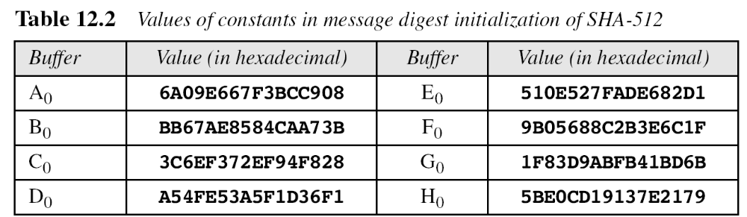
12.2.1 Continued
Message Digest Initialization
12.<number>

Slide 27
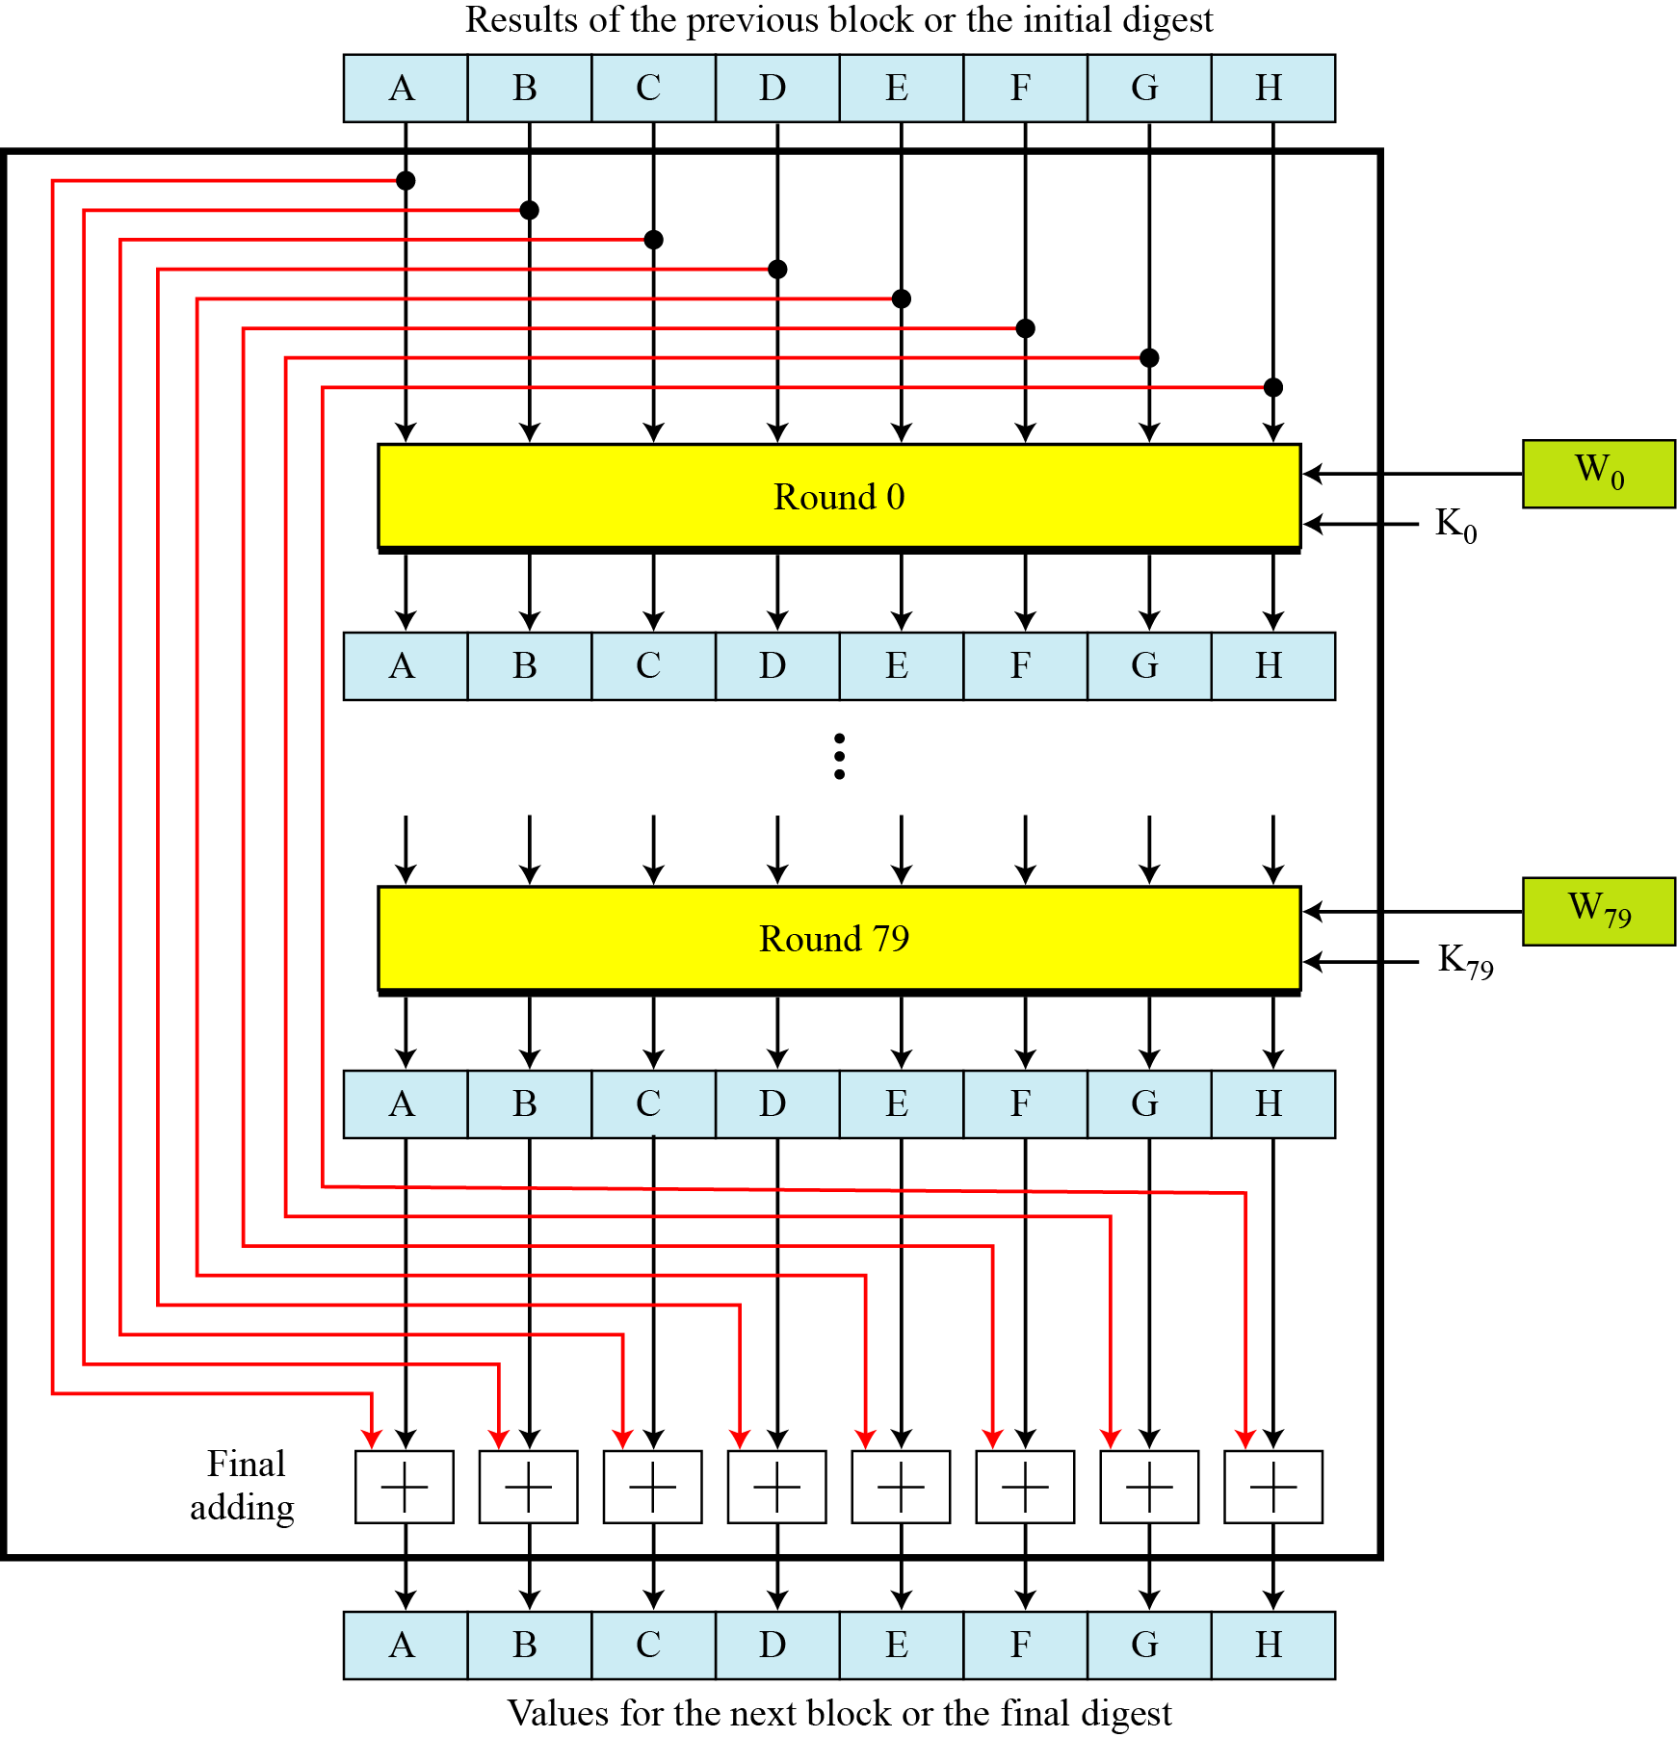
12.2.2 Compression Function
Figure 12.10 Compression function in SHA-512
12.<number>

Slide 28
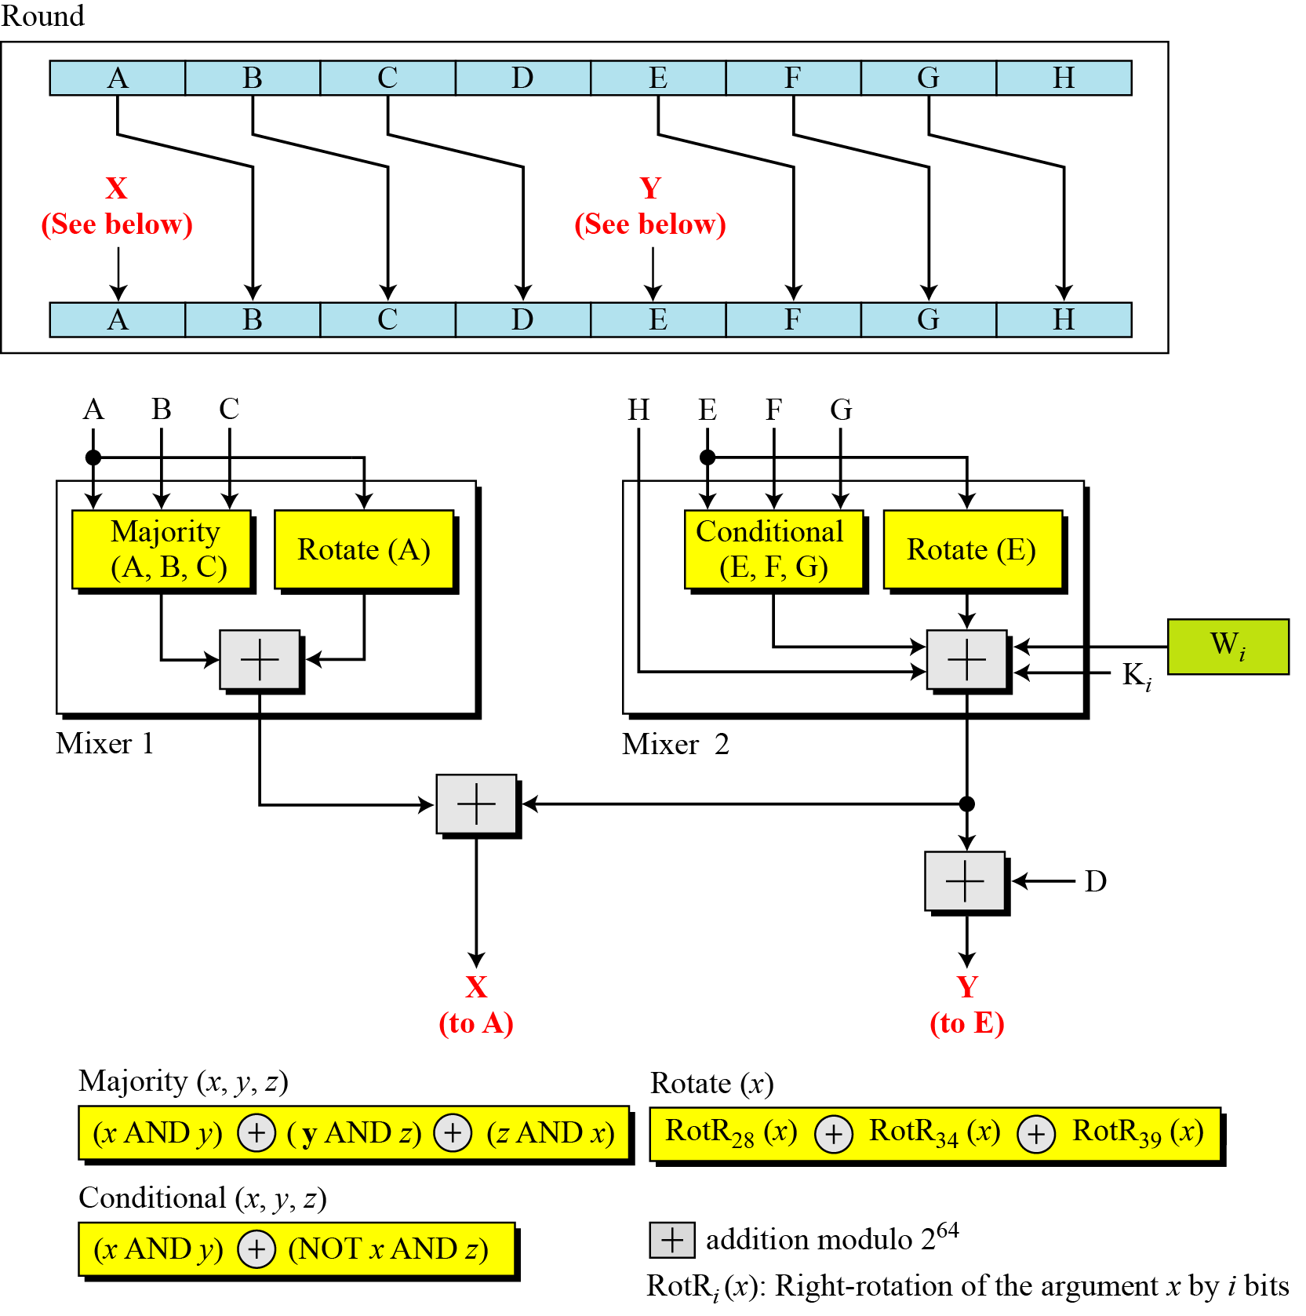
12.2.2 Continued
Figure 12.11 Structure of each round in SHA-512
12.<number>

Slide 29
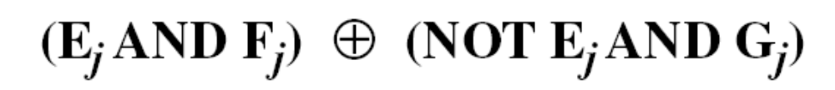
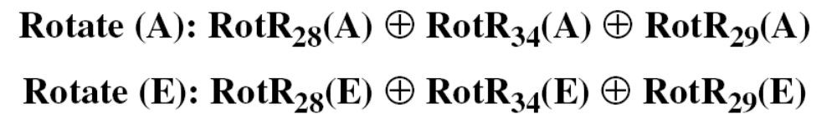
12.2.2 Continued
Majority Function
Conditional Function
Rotate Functions
12.<number>

Slide 30
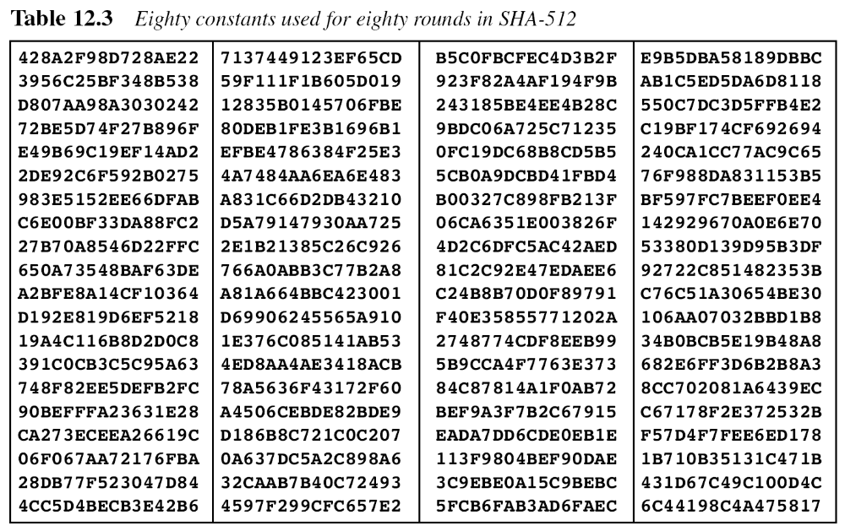
12.2.2 Continued
12.<number>

Slide 31
12.2.2 Continued
There are 80 constants, K₀ to K₇₉, each of 64 bits. Similar These values are calculated from the first 80 prime numbers (2, 3,…, 409). For example, the 80th prime is 409, with the cubic root (409)^{1/3} = 7.42291412044. Converting this number to binary with only 64 bits in the fraction part, we get
The fraction part: (6C44198C4A475817)₁₆
12.<number>

Slide 32
12.2.2 Continued
Example 12.7
We apply the Majority function on buffers A, B, and C. If the leftmost hexadecimal digits of these buffers are 0x7, 0xA, and 0xE, respectively, what is the leftmost digit of the result?
Solution
The digits in binary are 0111, 1010, and 1110.
a. The first bits are 0, 1, and 1. The majority is 1.
b. The second bits are 1, 0, and 1. The majority is 1.
c. The third bits are 1, 1, and 1. The majority is 1.
d. The fourth bits are 1, 0, and 0. The majority is 0.
The result is 1110, or 0xE in hexadecimal.
12.<number>

Slide 33
12.2.2 Continued
Example 12.8
We apply the Conditional function on E, F, and G buffers. If the leftmost hexadecimal digits of these buffers are 0x9, 0xA, and 0xF respectively, what is the leftmost digit of the result?
Solution
The digits in binary are 1001, 1010, and 1111.
a. The first bits are 1, 1, and 1. The result is F₁, which is 1.
b. The second bits are 0, 0, and 1. The result is G₂, which is 1.
c. The third bits are 0, 1, and 1. The result is G₃, which is 1.
d. The fourth bits are 1, 0, and 1. The result is F₄, which is 0.
The result is 1110, or 0xE in hexadecimal.
12.<number>

Slide 34
12.2.3 Analysis
With a message digest of 512 bits, SHA-512 expected to be resistant to all attacks, including collision attacks.
12.<number>

Slide 35
12-3 WHIRLPOOL
Whirlpool is an iterated cryptographic hash function, based on the Miyaguchi-Preneel scheme, that uses a symmetric-key block cipher in place of the compression function. The block cipher is a modified AES cipher that has been tailored for this purpose.
Topics discussed in this section:
12.3.1 Whirlpool Cipher
12.3.2 Summary
12.3.3 Analysis
12.<number>

Slide 36
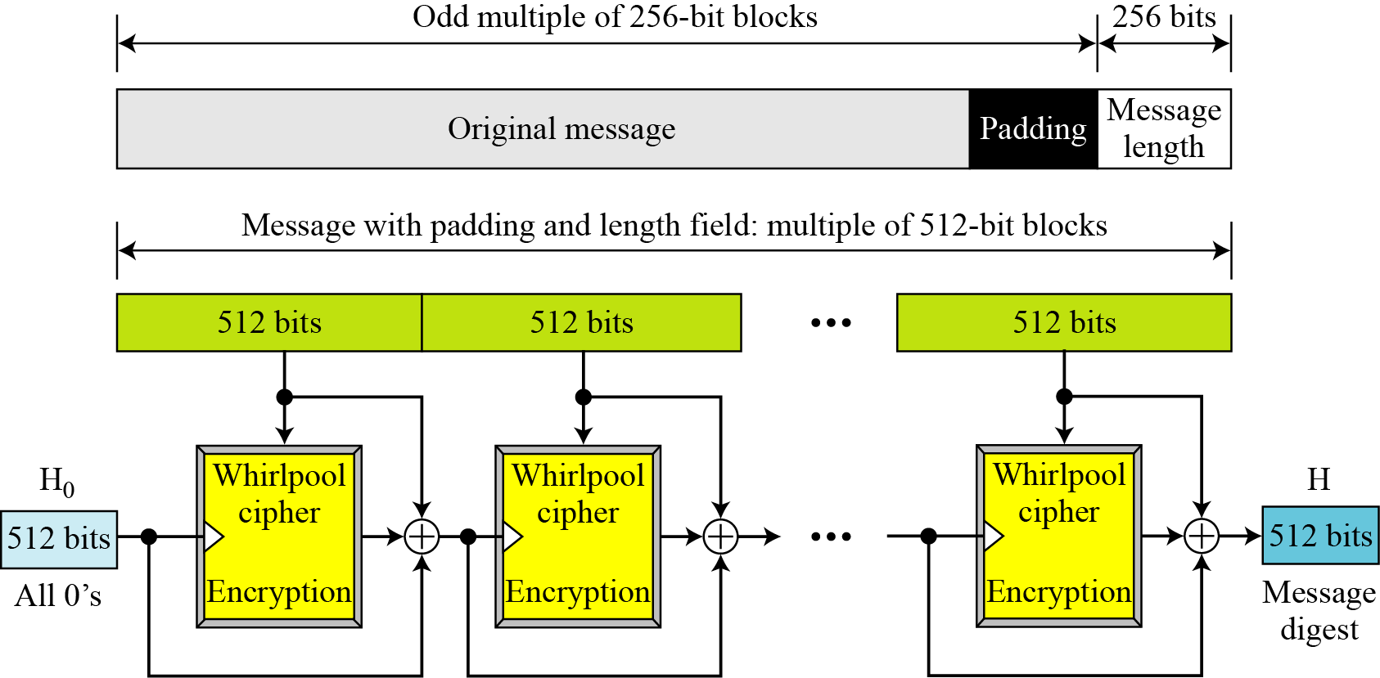
12-3 Continued
Figure 12.12 Whirlpool hash function
12.<number>

Slide 37
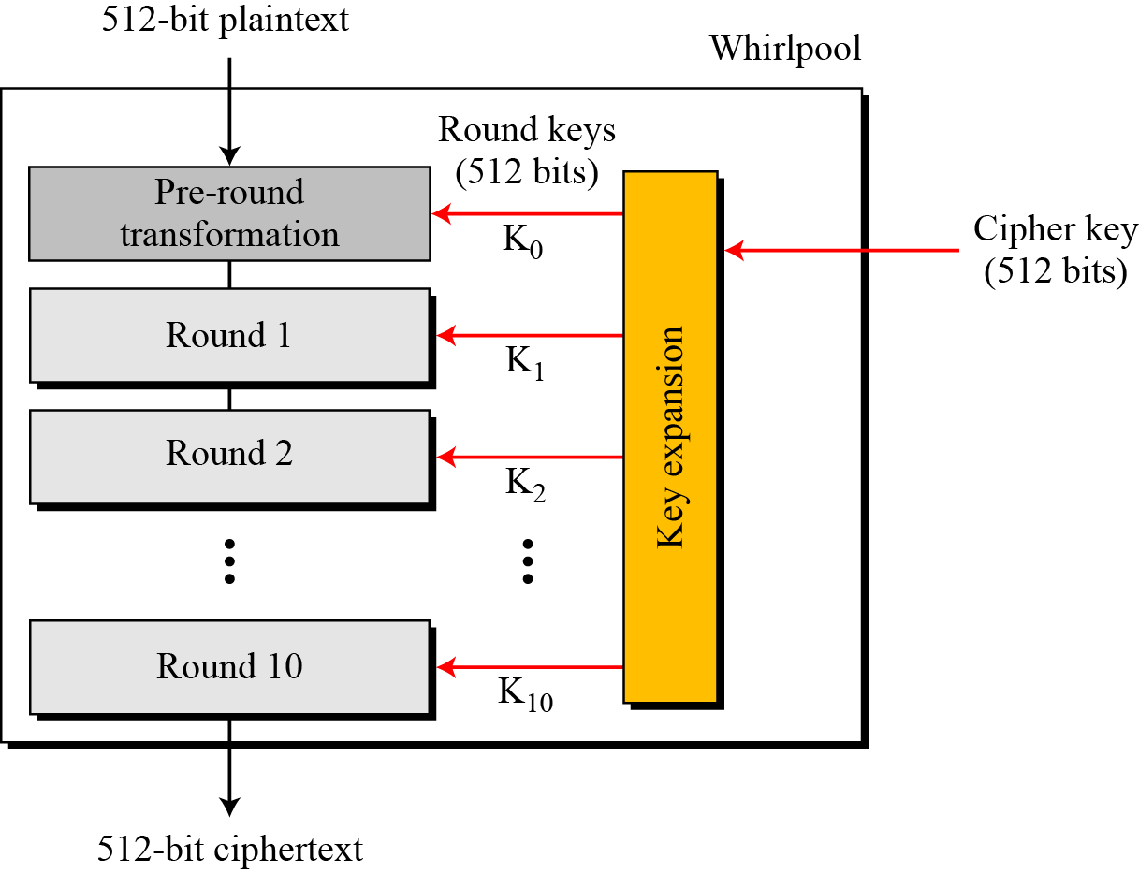
12.3.1 Whirlpool Cipher
Figure 12.13 General idea of the Whirlpool cipher
12.<number>

Slide 38
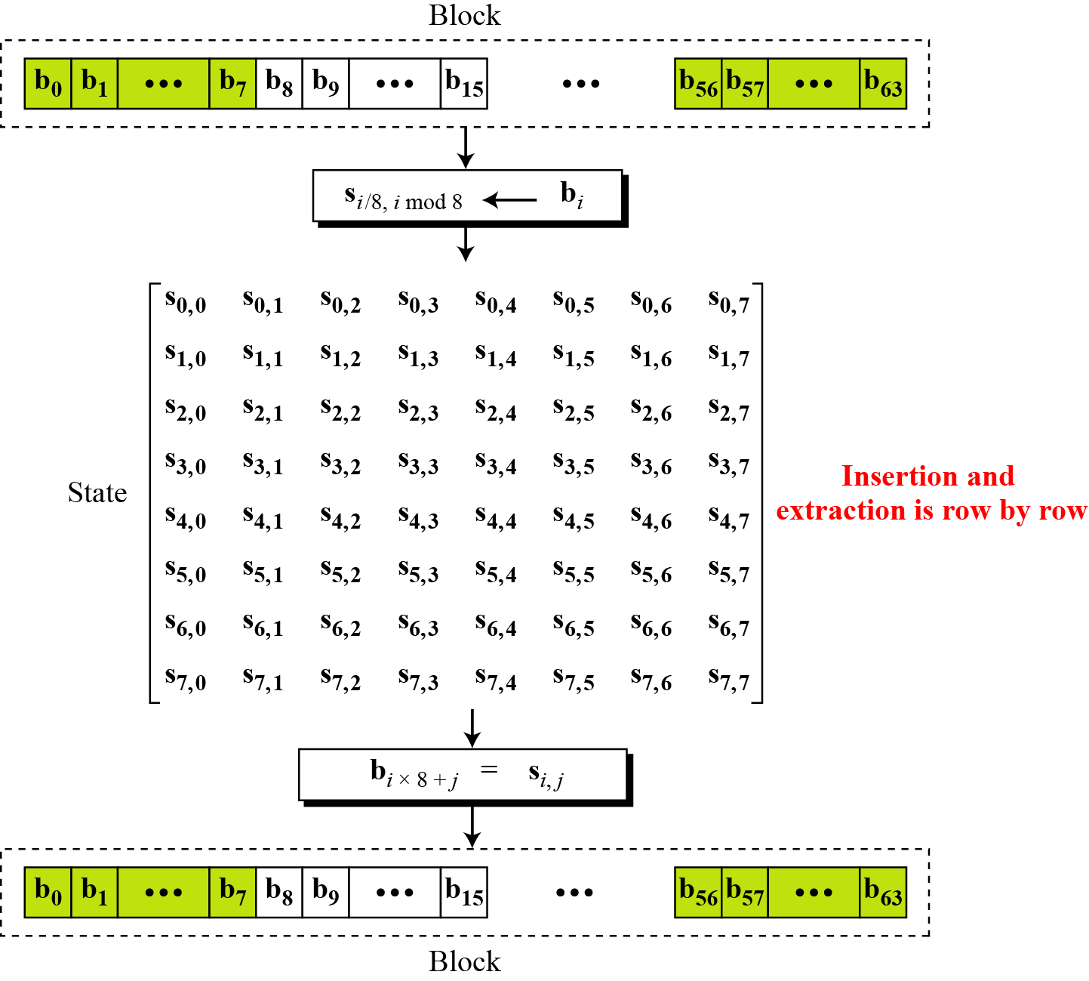
12.3.1 Continued
Figure 12.14 Block and state in the Whirlpool cipher
12.<number>

Slide 39
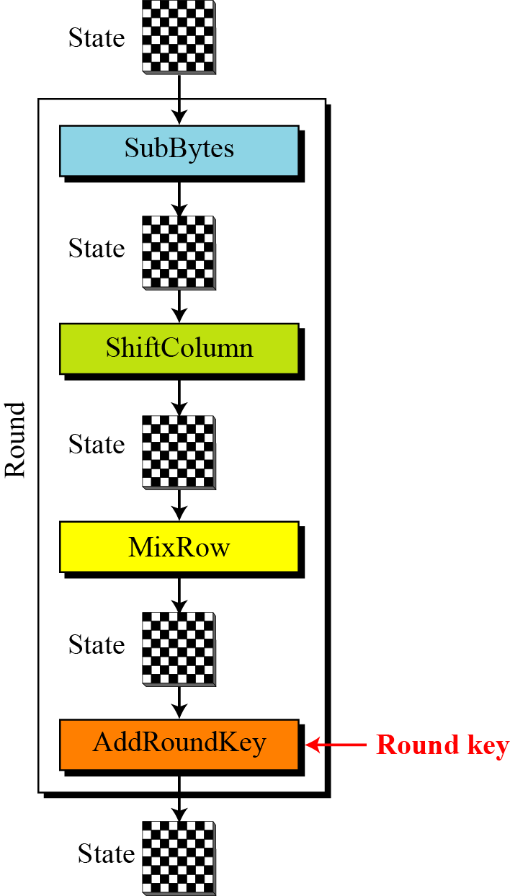
12.3.1 Continued
Structure of Each Round
Each round uses four transformations.
Figure 12.15 Structure of each round in the Whirlpool cipher
12.<number>

Slide 40
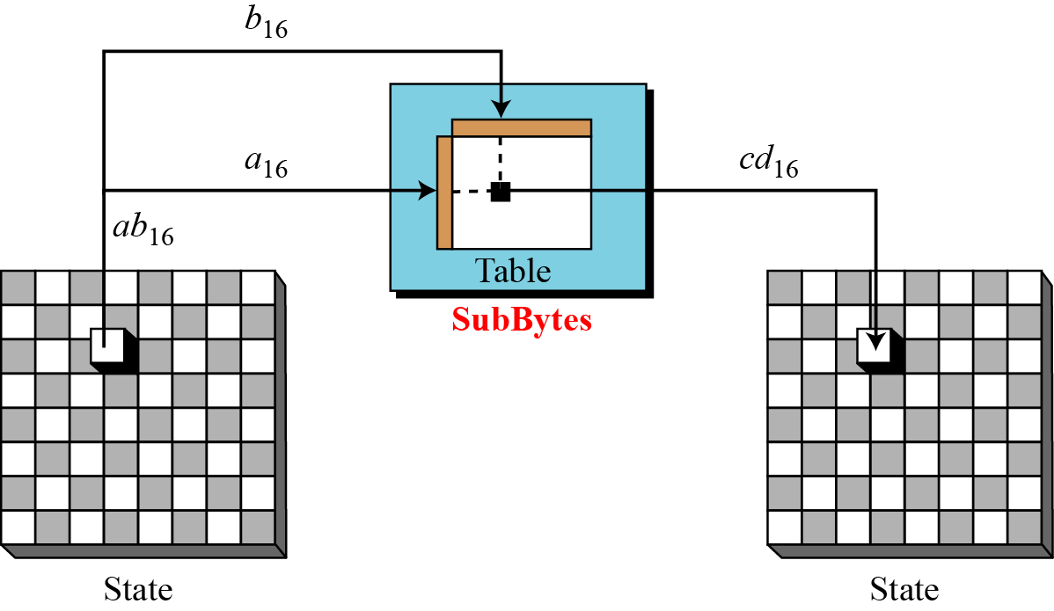
12.3.1 Continued
SubBytes Like in AES, SubBytes provide a nonlinear transformation.
Figure 12.16 SubBytes transformations in the Whirlpool cipher
12.<number>

Slide 41
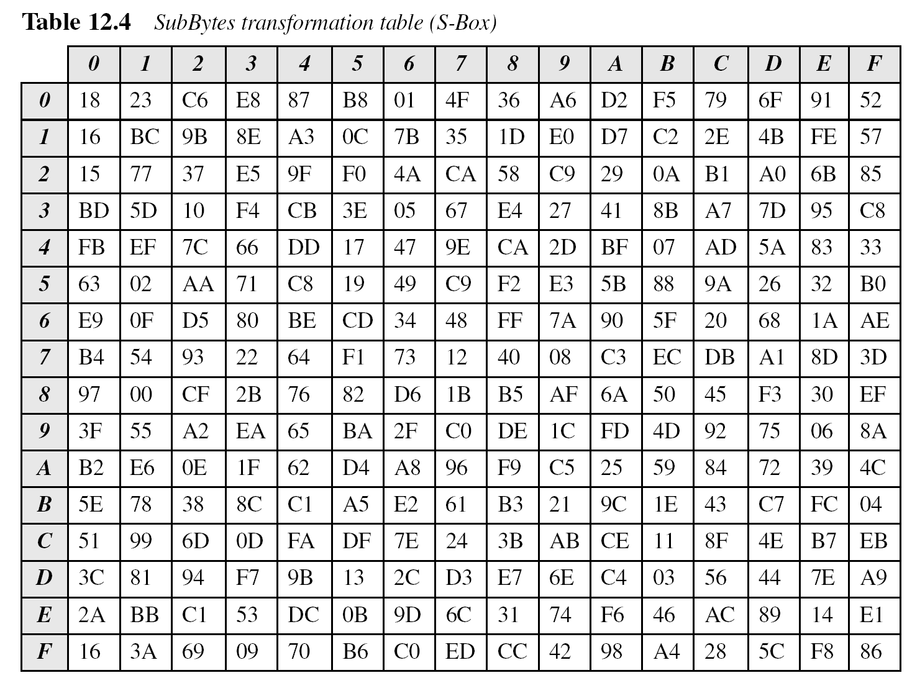
12.3.1 Continued
12.<number>

Slide 42
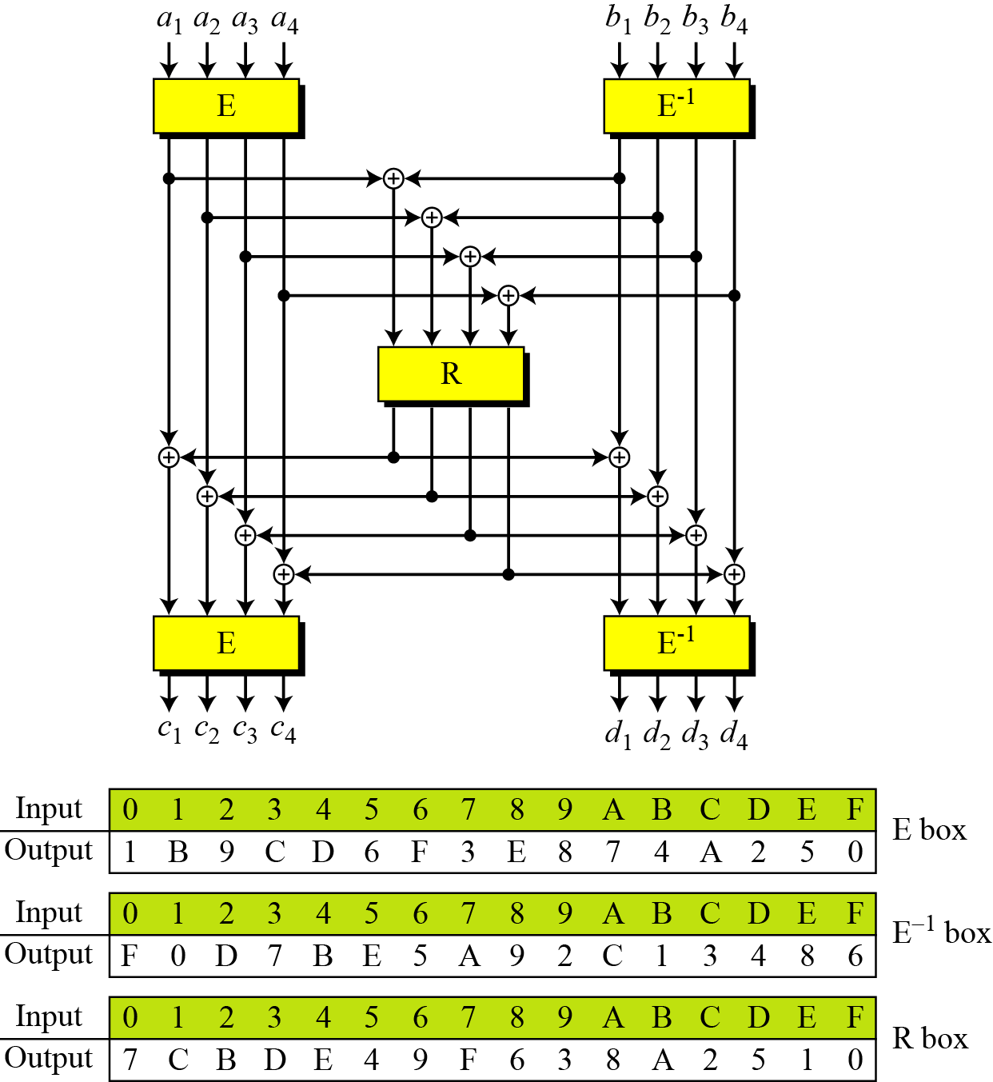
12.3.1 Continued
Figure 12.17 SubBytes in the Whirlpool cipher
12.<number>

Slide 43
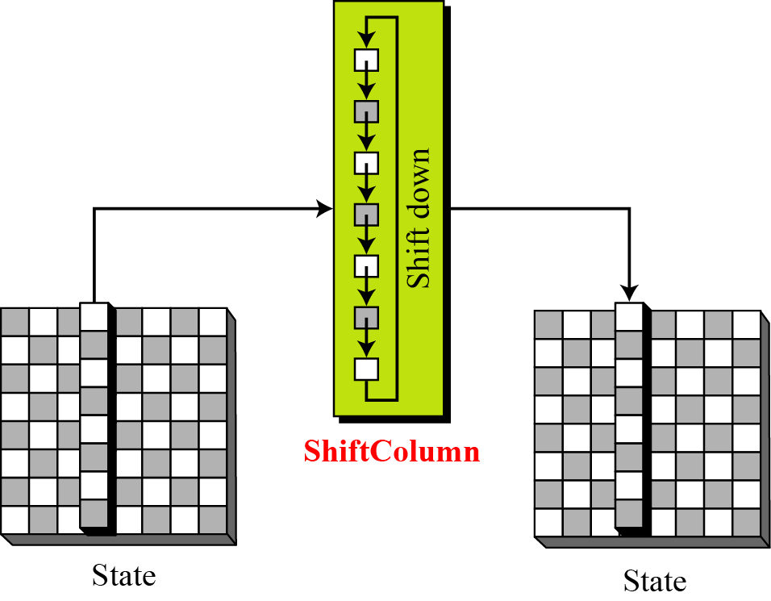
12.3.1 Continued
ShiftColumns
Figure 12.18 ShiftColumns transformation in the Whirlpool cipher
12.<number>

Slide 44
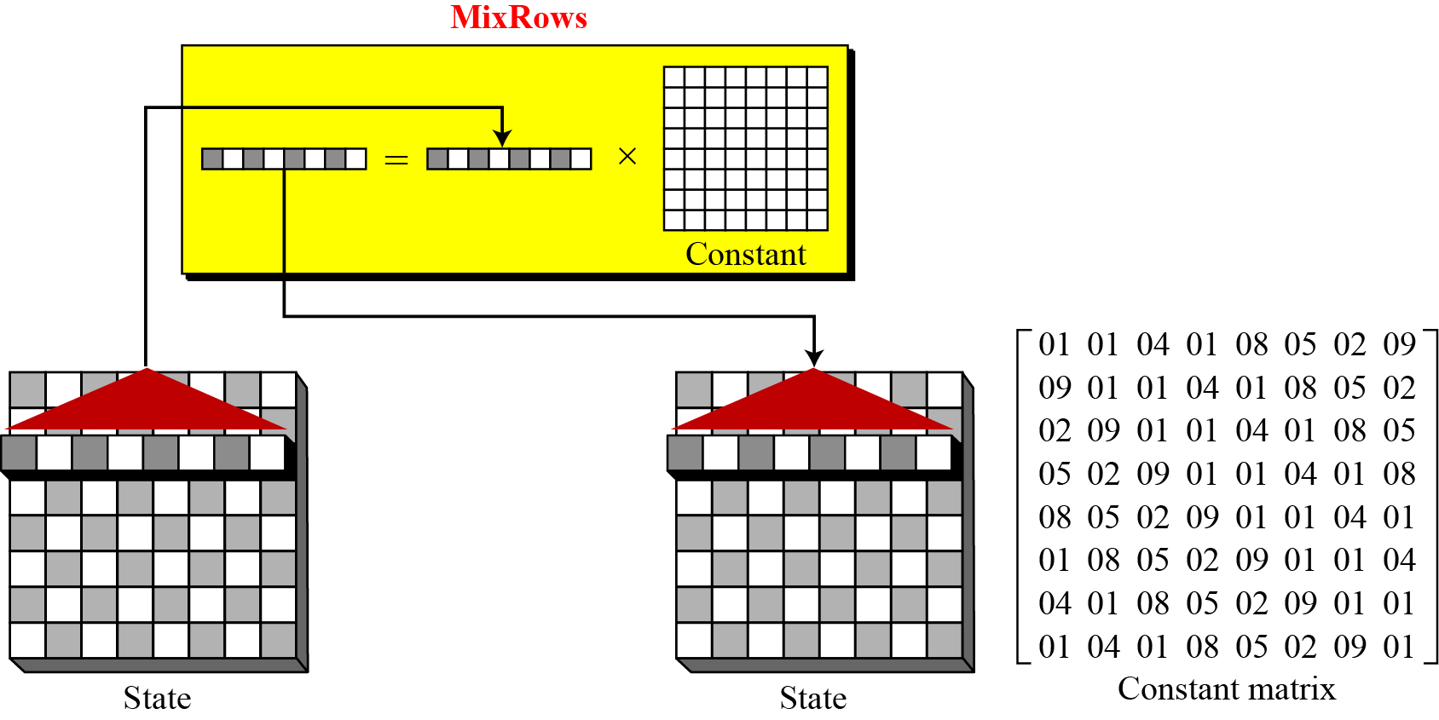
12.3.1 Continued
Figure 12.19 MixRows transformation in the Whirlpool cipher
12.<number>

Slide 45
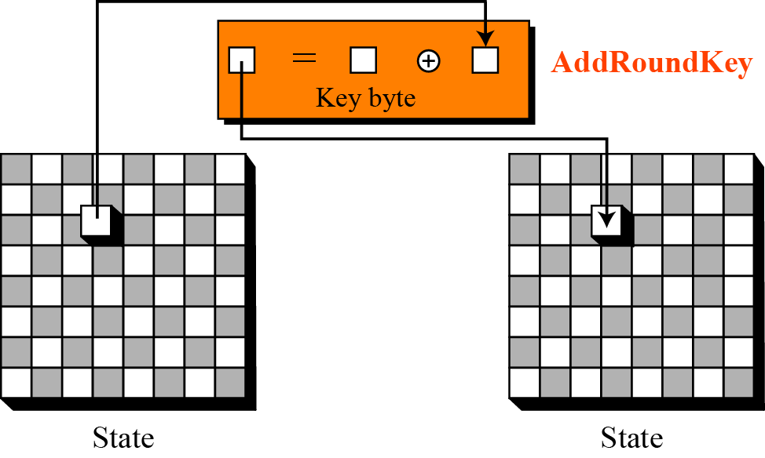
12.3.1 Continued
Figure 12.20 AddRoundKey transformation in the Whirlpool cipher
12.<number>

Slide 46
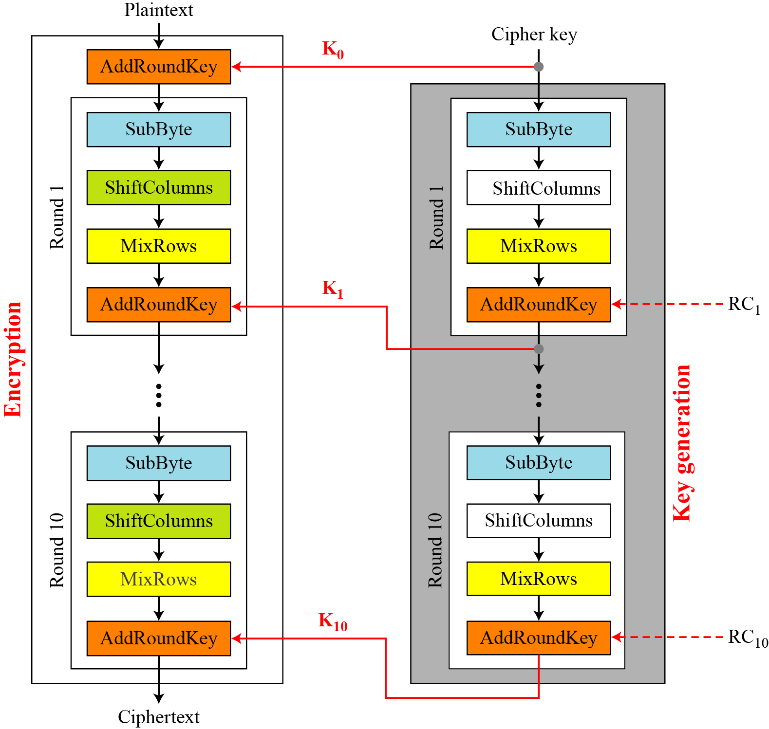
12.3.1 Continued
Figure 12.21 Key expansion in the Whirlpool cipher
12.<number>

Slide 47
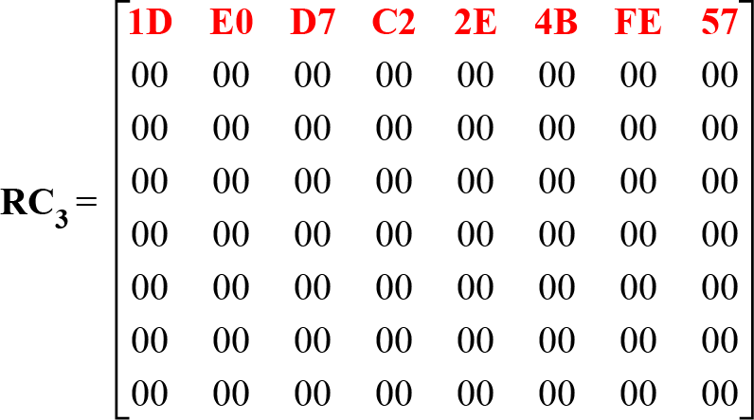
12.3.1 Continued
Figure 12.22 Round constant for the third round
12.<number>

Slide 48
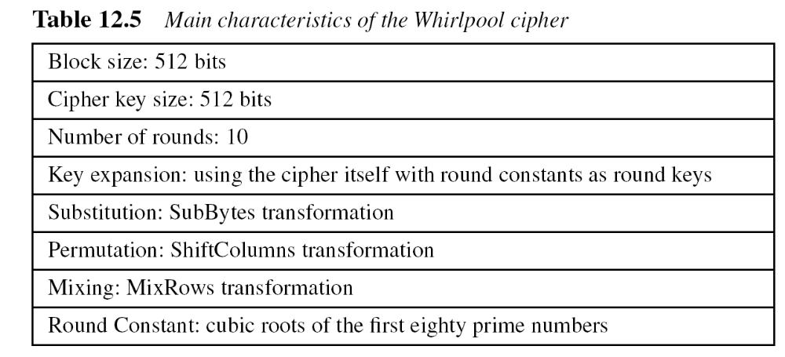
12.3.2 Summary
12.<number>

Slide 49
12.3.3 Analysis
Although Whirlpool has not been extensively studied or tested, it is based on a robust scheme (Miyaguchi-Preneel), and for a compression function uses a cipher that is based on AES, a cryptosystem that has been proved very resistant to attacks. In addition, the size of the message digest is the same as for SHA-512. Therefore it is expected to be a very strong cryptographic hash function.
12.<number>

